Slide 1









Microbial Hazards Risk Ranking
1
MiRA

Slide 2

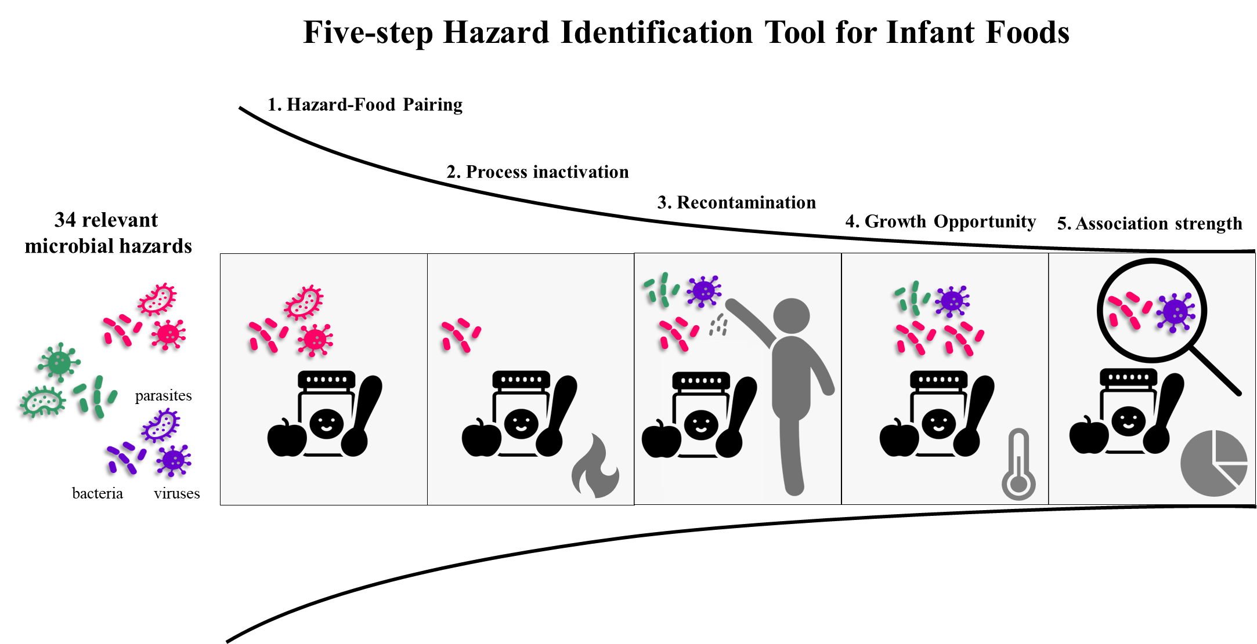

Hazard Identifcation is done prior to risk ranking to identify most relevant hazard in the selected foods

Slide 3








The Eight Risk Ranking Steps
S1
Food products selection & relevant hazard-food pairing
S2-S5
Hazard food characteristics of the selected food products
S6
Hazard Food Association of the selected food products
S7
Food consumption
S8
Hazard severity of the identified hazards
Optional
Additional evidence/ Include or exclude criteria
Select risk ranking methods
Aggregation and display ranking results

Slide 4
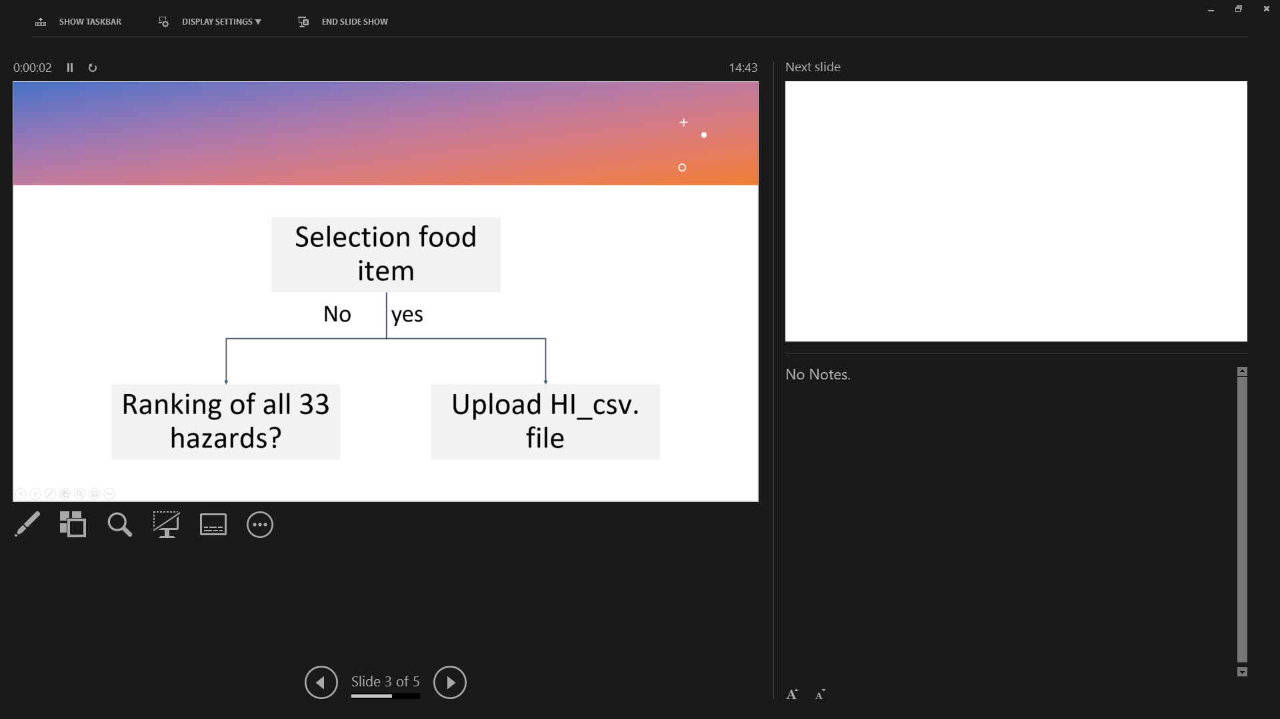
Food parameter: Select food item
User’s input
Mira
Selection food item
Selection food item
shows hierarchy & code on FoodEx2 next to food item
Ranking of all 34 hazards?
Ranking of all 34 hazards?
No
yes
No
yes
Default way
Upload HI_csv. file
No action is needed
Upload HI_csv. file
No action is needed
Provide link to MiID
https://foodmicrobiologywur.shinyapps.io/Microbial_hazards_ID/

Slide 5
Food parameter: select food composition
User’s input
Mira
Food composition
Food composition
Factors | Tick relevant
High fat | □ yes
Low Aw (0.5-0.9) | □ yes
Dry product (aw < 0.5) | □ yes
pH < 4.5 | □ yes
4.5 < pH < 4.8 | □ yes
pH > 10 | □ yes
Neutral | □ yes
This step influences the inactivation efficacy of the selected processing techniques in the next input
Check processing techniques of factory parameter
Take the corresponding value

Slide 6


Risk Ranking Criteria
Likelihood
Severity
Hazard-Food Characteristics
(HFC)
Hazard-Food Association
(HFA)
Food Consumption (FC) (C7)
DALY/case (HS)
(C8)
Processing survival (C2)
Recontamination (C3)
Post-processing control (C4)
🠚 IF: growth opportunity
🠚 EF: storage/distribution/retail
Meal preparation (C5)
Outbreak prevalence (C6A)
Food contamination prevalence (C6B)

Slide 7
Factory parameter: C2➔ processing techniques
User’s input
Mira
Techniques
Techniques + food composition
Thermal inactivation
Step 2_PE: relevant values in column H, I, or J is used. Display information on columns K &L based on the factory parameter selection
Factors | Tick relevant
High fat | □ yes
Low Aw (0.5-0.9) | □ yes
Dry product (aw < 0.5) | □ yes
pH < 4.5 | □ yes
4.5 < pH < 4.8 | □ yes
pH > 10 | □ yes
Neutral | □ yes
Pasteurizaiton
Boiling
Sterilization
When more than 1 factor is relevant, select the highest value

Slide 8
Decision tree
Risk value | Score
1E-20 | 1
1E-18 | 1
1E-12 | 1
1E-10 | 2
1E-8 | 2
1E-6 | 2
1E-5 | 2
1E-4 | 3
1E-3 | 3
1E-1 | 4
1 | 4
Processing inactivation effect
Select the processing techniques
Table 1
Thermal
None
High risk
Hazard group | No inactivation
Vegetative bacteria | 1
Virus | 1
Vegetative parasites | 1
Parasite cysts | 1
Heat-resistant virus | 1
Bacterial spores | 1
Bacterial toxin | 1
HPP
Pasteurize
Table 1
PCD
Boil
Select food composition
RF
Sterilize
Table 2
Dry food
High fat
No
Hazard group | Pasteurization | Boiling | Sterilization
Vegetative bacteria | 1E-6 | 1E-10 | 1E-20
Virus | 1E-6 | 1E-10 | 1E-20
Vegetative parasites | 1E-6 | 1E-10 | 1E-20
Parasite cysts | 1E-05 | 1E-10 | 1E-20
Heat-resistant virus | 1E-03 | 1E-10 | 1E-20
Bacterial spores | 1 | 1E-03 | 1E-12
Bacterial toxin | 1 | 1E-03 | 1E-12
Low risk
*exception rule
low risk for Campylobacter in dry foods
Table 2
yes
Medium risk
Table 3
Table 3
Hazard group | Pasteurization | Boiling | Sterilization
Vegetative bacteria | 1E-4 | 1E-8 | 1E-18
Virus | 1E-4 | 1E-8 | 1E-18
Vegetative parasites | 1E-4 | 1E-8 | 1E-18
Parasite cysts | 1E-3 | 1E-8 | 1E-18
Heat-resistant virus | 1E-1 | 1E-8 | 1E-18
Bacterial spores | 1 | 1E-1 | 1E-10
Bacterial toxin | 1 | 1E-1 | 1E-10

Slide 9
Factory parameter: C3➔ Recontamination
User’s input
Mira
Sources | Tick relevant
Aseptic processing | □ yes
Wet environment | □ yes
Dry environment | □ yes
Addition of dry herbs or spices | □ yes
Addition of dry vitamins | □ yes
Addition of other dry ingredients | □ yes
Human cross-contamination | □ yes
Sources | Tick relevant
Aseptic processing | □ yes
Wet environment | □ yes
Dry environment | □ yes
Addition of dry herbs or spices | □ yes
Addition of dry vitamins | □ yes
Addition of other dry ingredients | □ yes
Human cross-contamination | □ yes
Step 3_RP: pick the relevant columns and add the numerical values assigned for EF & RF

Slide 10
Decision tree
Category of dry ingredients | Risk of recontamination for relevant hazard
dry spices | 0.5
other dry ingredients | 0.05
dry vitamins | 0.005
Risk value | Score
1E-6 | 1
0.005 | 2
0.05 | 3
0.5 | 4
0 | 0
Recontamination =
R _{environmental factor +} R _{food handling}
Food handling
Yes
No risk and no addition of other ingredients
*Zero here indicates the entire branch of recontamination will be excluded from RR instead of multiplying with the value zero
Processing in close bag?
0
No
Environmental factor
Human contact with food?
Addition of unprocessed ingredients?
Include possible environmental contaminants?
No
Yes
No
Yes
Yes
Dry/Wet?
Dry?
No
*Addition of unprocessed wet ingredients are not examined in Mira-DSS
Yes
Yes
None/very low risk
Minor risk with MH- dry/wet environment
None/very low risk
Minor risk with MH- humans
Major risk with MH- dry ingredients
*Assuming 50% of 100% of unprocessed ingredients may be contaminated
1E-6
0.001
1E-6
0.001
0.005

Slide 11
Distribution parameter: C4 ➔ Conditions during storage/distribution/retailing
User’s input
Mira
Storage/distribution/retail | Tick relevant
Room temperature | □ yes
Refrigeration (1-4°C) | □ yes
Frozen (0°C) | □ yes
Potential temperature abuse | □ yes
Storage/distribution/retail | Tick relevant | Food composition filled by user | Cardinal parameter
Room temperature | □ yes | Take data in food parameter | Compare with cardinal parameter in Supplementary Table X, & take the estimated likelihood in step 4_ PPC2
Refrigeration (1-4°C) | □ yes
Frozen (0°C) | □ yes
Potential temperature abuse | □ yes

Slide 12
Decision tree
Risk value | Score
1E-6 | 1
1E-3 | 2
1 | 3
Post-processing control
Growth Opportunity
No
Hazard needs growth in food to cause illness?
yes
Food characteristic ?
pH <4.5 or >4.5
Dry/half dry/wet
Food characteristics support hazard growth?
No
*Only yes/no growth in food characteristics is taken into consideration, with exceptions for some strains that can otherwise grow in the conditions they cannot grow are
are not taken into consideration
yes
Storage/distribution/retailing conditions
RT
Cold
1-4°C
Freeze
0°C
Potential temperature abuse?
High risk
medium risk
low risk
1
1.00E-03
1.00E-06

Slide 13
Distribution parameter: C5 ➔ Meal preparation at household
User’s input
Mira
Step 5_MP: pick the value in the relevant columns E, F or G
Meal preparation | Tick relevant
Ready to eat | □ yes
Ready to heat <70°C | □ yes
Ready to cook > 70°C | □ yes
Hazard group | RTE | RTH <70°C | RTC >70°C
Vegetative bacteria | 1 | 1E-2 | 1E-4
Virus | 1 | 1E-2 | 1E-4
Vegetative parasites | 1 | 1E-2 | 1E-4
Parasite cysts | 1 | 1E-1 | 1E-03
Heat-resistant virus | 1 | 1 | 1E-02
Bacterial spores | 1 | 1 | 1
Bacterial toxin | 1 | 1 | 1

Slide 14
Decision tree
Effect of meal preparation
Table 4
Hazard group | Cooking <70C | Cooking >70C
Vegetative bacteria | 1E-2 | 1E-4
Virus | 1E-2 | 1E-4
Vegetative parasites | 1E-2 | 1E-4
Parasite cysts | 1E-1 | 1E-03
Heat-resistant virus | 1 | 1E-02
Bacterial spores | 1 | 1
Bacterial toxin | 1 | 1
Further cooking/prep process involved?
Ready to eat foods
Thermal Cooking > 70°C
Risk value | Score
1E-4 | 1
1E-3 | 1
1E-2 | 2
1E-1 | 3
1 | 4
High risk
Medium risk
low risk
1
Table 4
Table 4
* Meal preparation ELIMINATES no hazards

Slide 15
C6, C7 and C8: Prevalences, Consumption and Severity data
User’s input
Mira
Based on user’s input in step 1, display the respective data column in Step 6_HFA4th root, Step 7_FC and Step8_HS values
Parameter | Criteria
Food | item Composition Acidity
Show total ranking of results in a Table
Show total ranking of results in a plot

Slide 16
Decision tree
Hazard Prevalence
Food Consumption
Consumption % by Infants/toddlers in EU ?
Contamination alerts
(US & EU)
Outbreak
(US & EU)
Sampling
(meta-analysis)
Actual consumption percentage in the population of infants and toddlers up to the age of 3 in EU (%)
NR
Strength of evidence (%)
*Assuming 1/million chance it may be the exception
1E-6
Prevalence percentage | Risk value | Score
NR | 0.000001 | 1
< 1% | <0.01 | 2
1-10% | 0.011-0.1 | 3
10.1 - 40% | 0.101 - 0.4 | 4
> 40% | > 0.4 | 5
Consumption percentage | Risk value | Score
NR | 0.000001 | 1
< 1% | <0.01 | 2
1-10% | 0.011-0.1 | 3
10.1 - 40% | 0.101- 0.4 | 4
> 40% | > 0.4 | 5

Slide 17
Decision tree
Risk value (DALY/case) | Score
< 0.05 | 1
0.05-0.5 | 2
0.51-5 | 3
> 5 | 4
Hazard severity
DALY reported?
DALY/case <0.05
Low impact hazard
Low-risk and usually self-limiting
DALY/case = 0.05- 0.5
Minor impact hazard
Minor risk and may require medical treatment
Other data available for calculation?
DALY/case = 0.51-5
Severe impact hazard
Medium risk and mainly require medical treatment
Assumption based on closely-related species that have similar sequelae
High risk and causes severe illness/death to victims
DALY/case > 5
Critical impact hazard

Slide 18
User input and default data in Mira DSS
User’s input
Default data
Parameter | Criteria
Food | Composition: pH; a_{w;} fat content
Factory | C2 Processing techniques C3 Recontamination
Distribution | C4 Storage, distribution and retail conditions C5 Meal preparation
Parameter | Criteria
C6 Prevalence Outbreak Contamination | Default value is automatically added into the calculation
C7 Food consumption
C8 Severity

Slide 19
Total Risk Aggregation
$$Total Risk = (C2 +{C3}^{b})∗ C4∗ C5∗ (C6A∗C6B) ^{\frac{1}{n} }∗C7∗ C8$$
If food composition = high fat AND dry product ➔ C2: Take the highest value
If more than one recontamination category is selected, then
C3 recontamination= C3a + C3b + C3n...
n = 4 in Mira- DSS referring to the total of 4 sources used to derive the prevalences of a hazard in the selected food. Check publication for details

